Slide 1
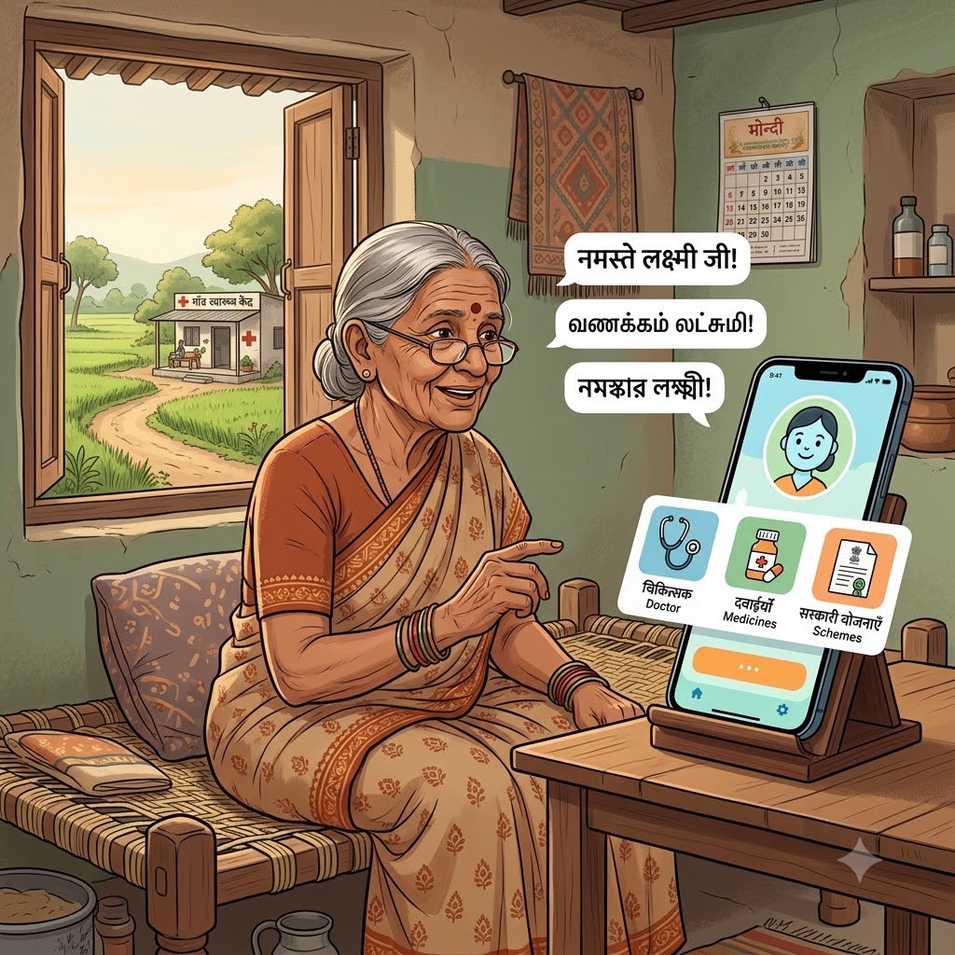


DECODE SIH 2026
OSCode
by communityX
🏆Bharat Shakti
PROBLEM STATEMENT 1
AI Rural Health Assistant — Multilingual
Healthcare Access & Government Scheme Guidance
THEME : HEALTH TECH
PRESENTED BY:
CODE ALCHEMISTS
“ONE VOICE COMMAND, INSTANT HEALTHCARE GUIDANCE.”

Slide 2
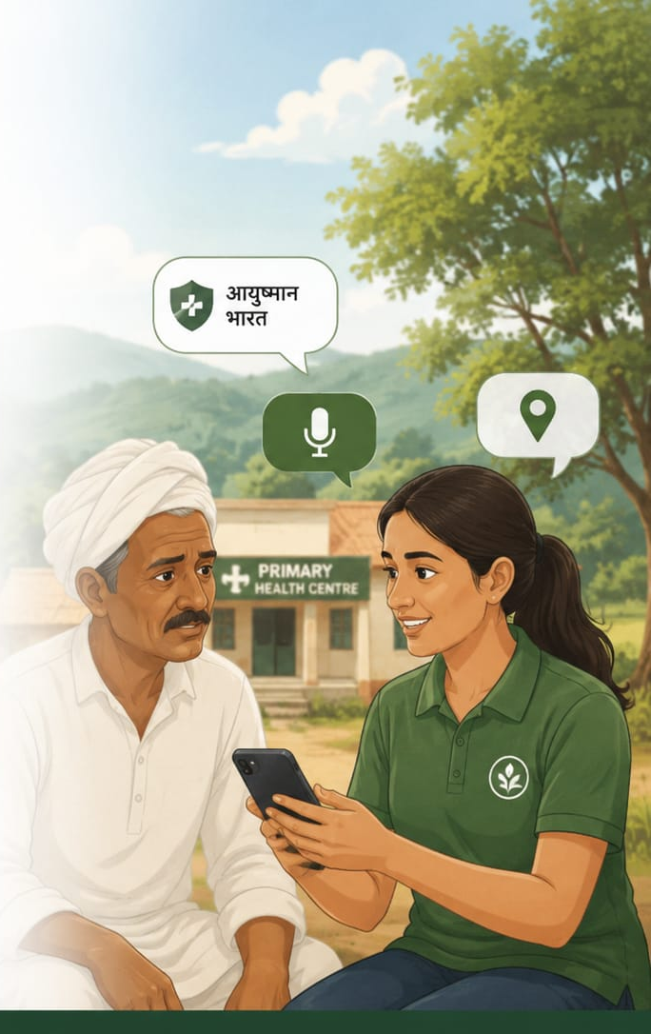
REAL WORLD PROBLEM
TEAM MEMBERS KAMALESHWARAN B (TEAM LEAD) VISHNUVARDHAN B KEVIN CRIS F JOHN EZRA P SRIHARINI D POOJA SRI AB
Language and Literacy Barriers: Rural citizens face severe barriers accessing healthcare because vital scheme details are only available in formal languages and complex forms they cannot easily read.
Lack of Program Awareness: Consequently, millions of vulnerable families remain completely unaware of their eligibility for crucial government programs like Ayushman Bharat.
Difficulty with Symptom Triage: During sudden illnesses, patients struggle with safe symptom triage, leaving them unsure whether to seek home care or emergency medical help.
Inability to Locate Facilities: Patients face significant challenges in easily locating the nearest healthcare facilities when they need them.
"FROM RURAL SYMPTOM TO RIGHT SOLUTION IN YOUR MOTHER TONGUE."

Slide 3
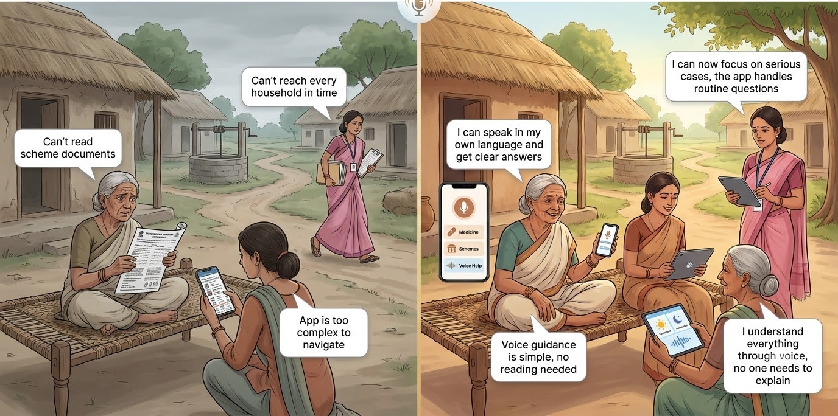
PROBLEM STATEMENT
OSCode
by communityX
What Does This Problem Aim to Solve?
Low awareness of government schemes-Rural citizens may not know they are eligible for schemes like Ayushman Bharat.
Language & literacy barriers
Uncertainty during illness
Difficulty finding healthcare
Lack of accessible guidance
Who Faces This Issue?
Why We Chose This Problem?
Language is the real barrier-Most digital health tools are English/Hindi-only — unusable for millions of regional-language, low-literacy rural users.
Awareness gap, not policy gap
ASHA workers are overburdened
BEFORE
AFTER
"NO INTERNET, NO BARRIER, JUST TRUE HEALTH INCLUSION."

Slide 4
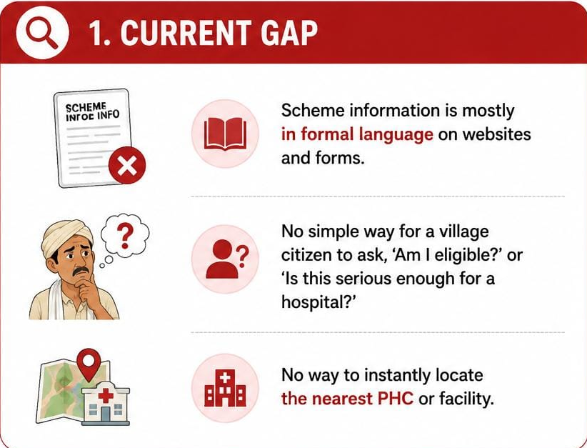
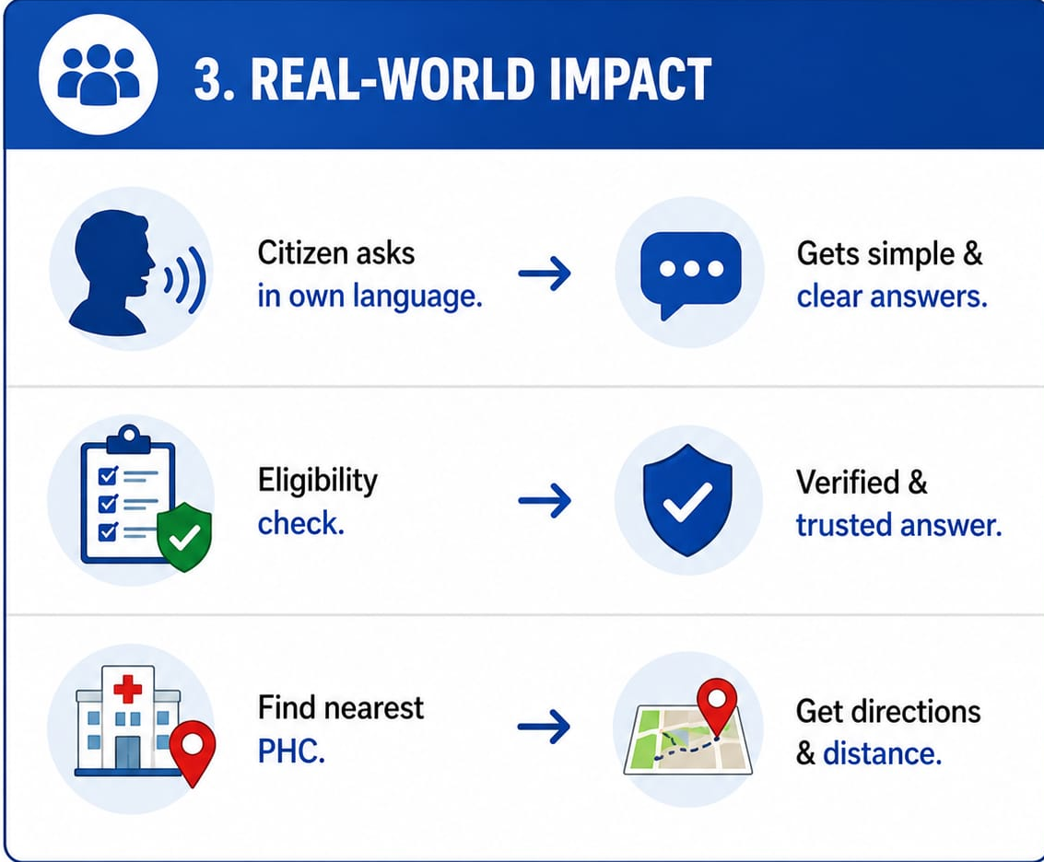
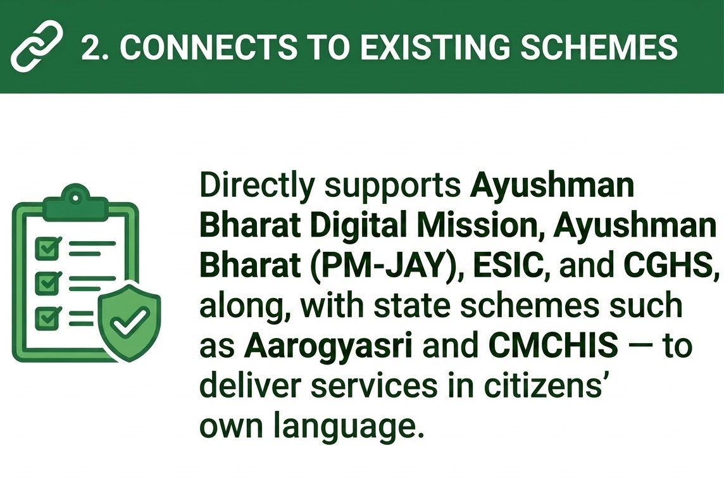
REAL-WORLD PROBLEM ALIGNMENT
How does your proposed solution fill that gap practically?
A voice-first assistant lets users speak in Tamil, Hindi, Telugu, and more.
Home Care | PHC | Emergency Rule-based and grounded in medical guidelines.
Smart Facility Finder-Nearest PHC / Hospital / Telemedicine Centre.
Document Intelligence Scan relevant government documents to simplify eligibility verification.
OSCode
by communityX
What’s the current gap in the system?
Scheme information exists only in formal language on websites and forms.
There’s no simple way for a village citizen to ask, in their own dialect, ‘am I eligible?’ or ‘is this serious enough for a hospital?’
And no way to instantly locate the nearest PHC.
Connects to existing schemes
Directly supports Ayushman Bharat (PM-JAY), the Ayushman Bharat Digital Mission, and the National Health Mission — and aligns with the Digital India vision of bringing government services to citizens in their own language.
Ayushman Bharat and other government schemes
Eligibility
Documents
Application Guidance
"BRIDGING THE HEALTHCARE GAP, ONE SPOKEN WORD AT A TIME."

Slide 5
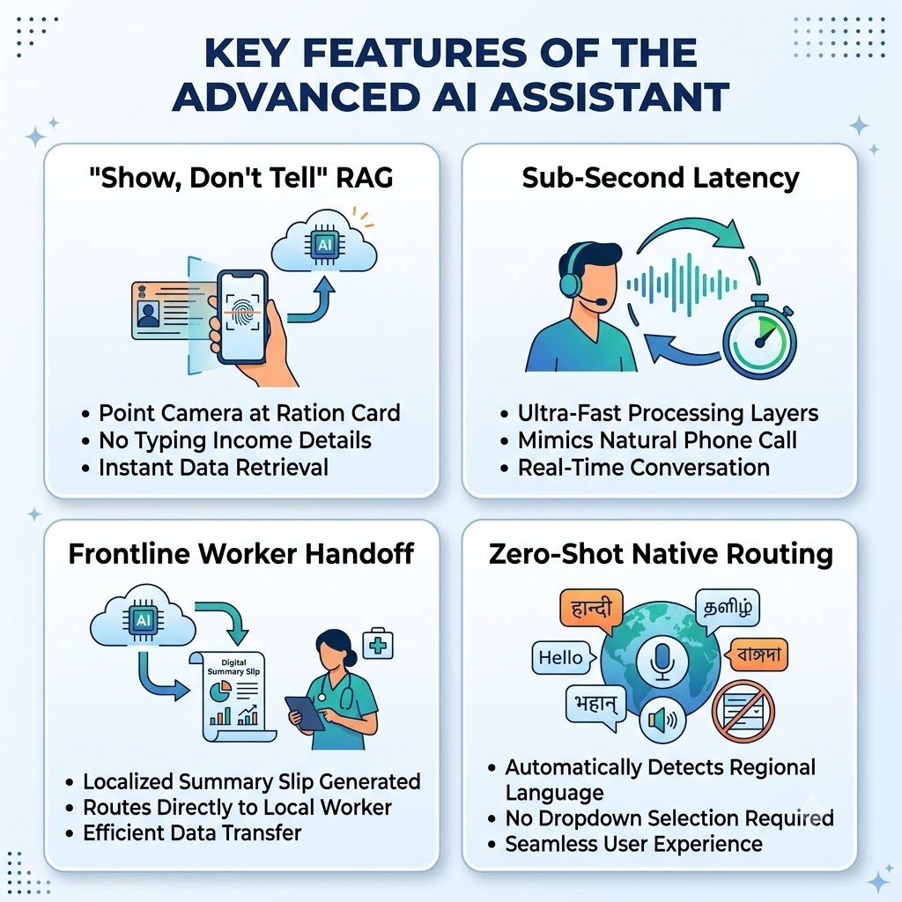
PROPOSED SOLUTION
OSCode
by communityX
ArogyaVani AI The Voice of Health for Bharat
A voice-first AI copilot that makes healthcare and government welfare services accessible to rural citizens without requiring them to read, type, or navigate complex portals.
Speak
Understand
Get Guidance
Reach Care
What Are The 3-4 Key Features?
1) Voice-first multilingual query & response in the user’s own dialect.
2) Source-grounded scheme eligibility & safe rule-based symptom triage.
3) Nearest health facility locator.
4) SMS/USSD fallback for low-connectivity areas.
What Makes It Different Or Innovative?
Trust & Accuracy—Never Guesses. Every answer is grounded and cited from official scheme documents and WHO/ICMR protocols
Literacy-Proof by Design — Speaks Their Visual Language. Beyond text and voice generates simple, audio-narrated pictorial guides (e.g., medicine timings, vaccination steps) in local dialects.
Universal Accessibility — Genuinely Reaches Everyone. Works seamlessly across voice, app, and SMS/USSD Built for low-end phones and unstable rural networks — no one is left out
"Empowering frontline workers and protecting rural families with voice-first AI."

Slide 6
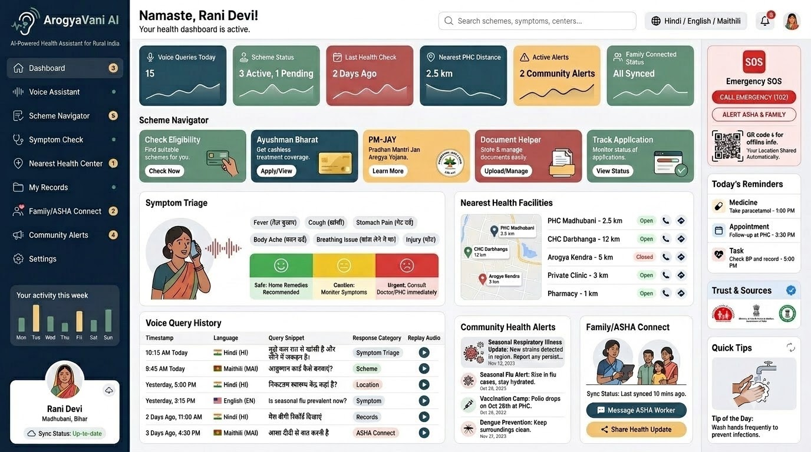
What Are You Building?
OSCode
by communityX

Slide 7
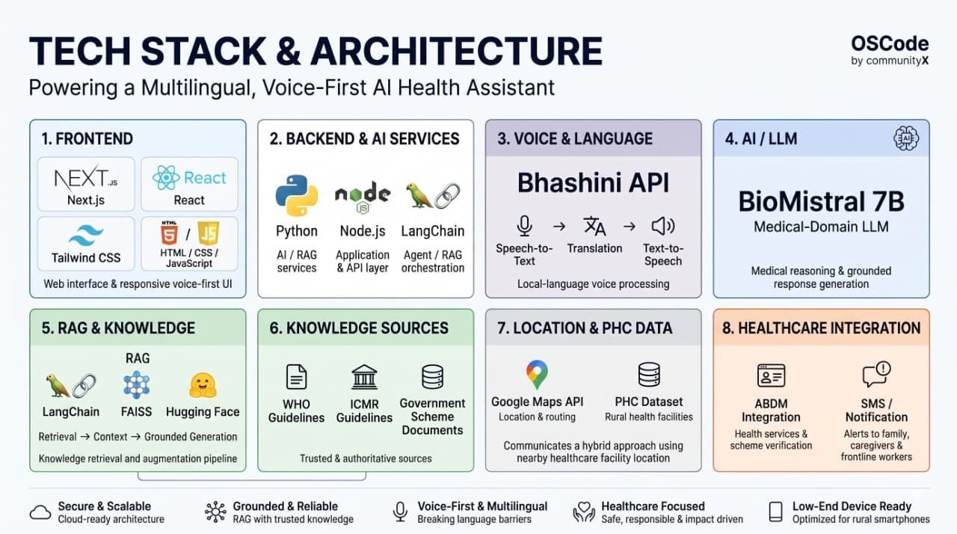

Slide 8
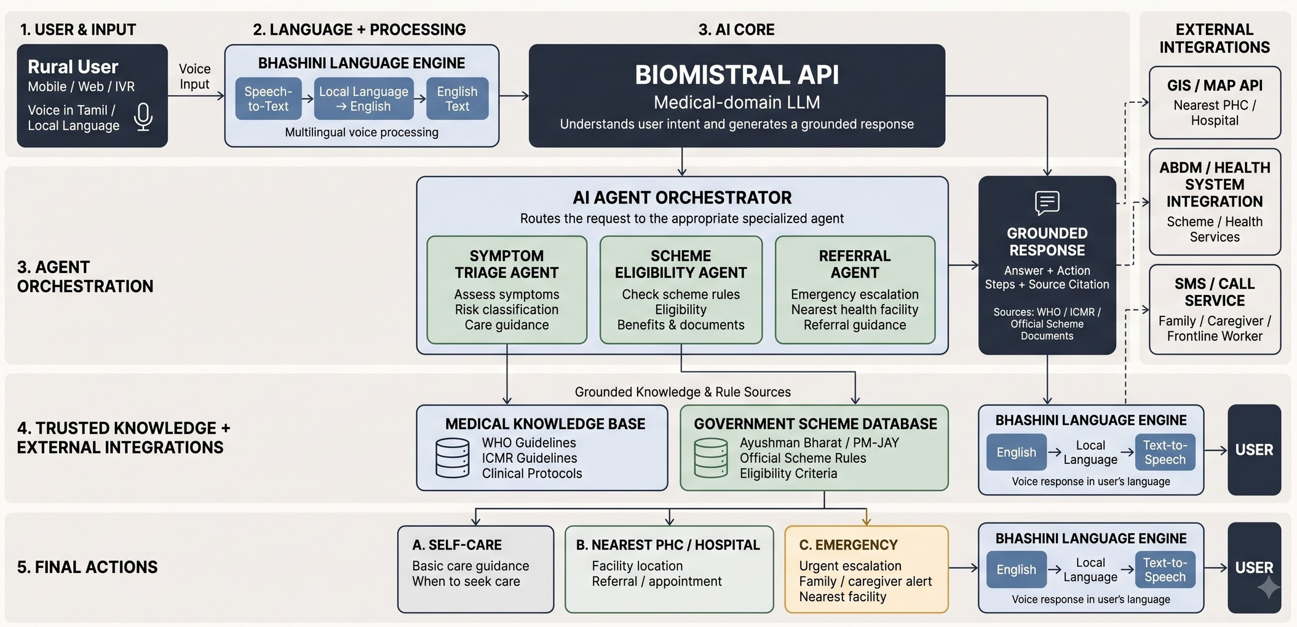
OSCode
ARCHITECTURE DIAGRAM
by communityX
End-to-end flow: Voice input → Bhashini language layer → RAG + Triage reasoning → grounded LLM answer → voice/SMS response back to the citizen.

Slide 9
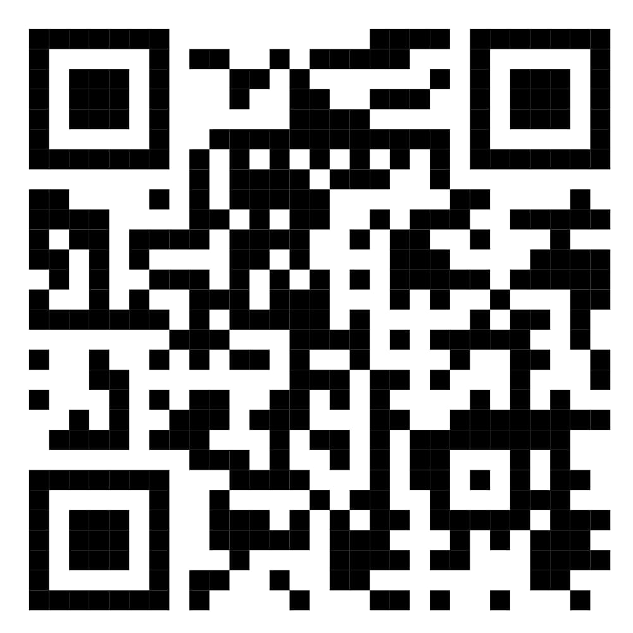
OSCode
RESEARCH AND RESOURCES
by communityX
📂 OUR PROJECT REPOSITORY:
National Health Authority (NHA), Government of India Ayushman Bharat Digital Mission (ABDM) ⁠￼ https://abdm.gov.in/abdm
National Health Authority (NHA), Government of India Health Facility Registry (HFR) https://abdm.gov.in/health-facilities
National Health Authority (NHA), Government of India ABDM — Multilingual Support & Citizen Services https://abdm.gov.in/call-center
⁠National Health Mission (NHM), Ministry of Health & Family Welfare, Government of India Accredited Social Health Activist (ASHA) Programme https://nhm.gov.in/nammamihaan/index1.php?lang=1&level=1&lid=226&sublinkid=150
⁠5. World Health Organization (WHO) Interagency Integrated Triage Tool
https://www.who.int/tools/triage ⁠￼
6. National Health Authority (NHA), Government of India ABDM — Health Facility Registry
& Digital Health Ecosystem https://abdm.gov.in/ebook
⁠￼
✅Research Papers & References
✅High-quality Model Images & Flowcharts ✅Future Scope Concept
SCAN ME
"SPEAK IN YOUR DIALECT, SECURE YOUR HEALTH."

